Slide 1
Welcome!
Hari Polnati

Slide 2
Agenda
Spring Boot: We can Build an end-to-end App
Essentials
Understanding on Web, N-tier Enterprise applications
Spring Modules
Dependency Injection
Spring vs Spring boot
Spring boot project with Spring initializer
Hello world API with Spring boot ☺
Spring Boot Magic – Starters, Auto Configuration, Embedded servers
Spring boot Actuator, devtools
Understanding REST API – Richardson maturity model
Configuration and customization
What is Persistence Frameworks and Integration with Spring Boot
Spring data JPA and CRUD operations with either mysql or mongodb
Exception handling
Profiling, Logging(levels)
Consumes REST API’s from spring boot app to another app. –Assignment
Overview on Microservices
Optional : Dockizing spring boot app and What is K8S

Slide 3
Spring Boot - Essentials

Slide 4
Prerequisites
Basics of Java SE

Slide 5
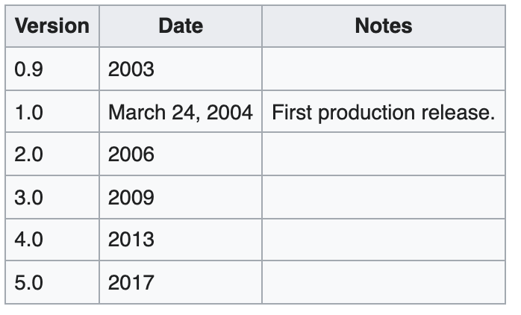
Initiated by
Rod Johnson
Official doc for Spring: https://spring.io/

Slide 6
What are Web Applications?
Web applications are distributed applications by nature. This means that any program that runs on more than one computer and communicates using the network and server. Web applications are accessed using a web browser, so they are very popular for the ease of using the browser as a user client. The ability to update and maintain web applications without installing any software on thousands of client computers becomes a key reason for the demand.
A web application is a dynamic extension of a web or application server. There are two types of web applications:
Presentation-oriented: A presentation-oriented web application generates interactive web pages containing various types of markup language (HTML, XML, and so on) and dynamic content in response to requests
Service-oriented: A service-oriented web application implements the endpoint of a web service. Presentation-oriented applications are often clients of service-oriented web applications.

Slide 7
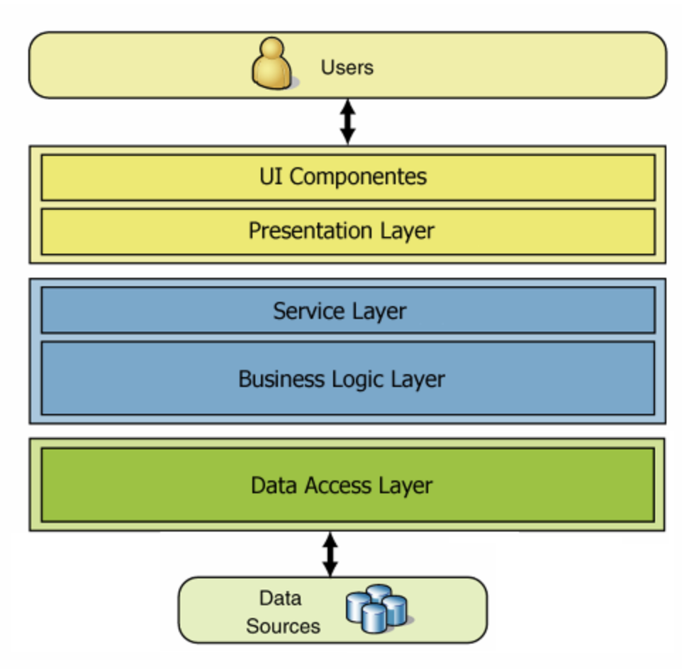
N-Tier Applications
An N-Tier Application program is one that is distributed among three or more separate computers in a distributed network.
The most common form of n-tier is the 3-tier Application, and it is classified into three categories.
User interface programming in the user’s computer
Business logic in a more centralized computer, and
Required data in a computer that manages a database.

Slide 8
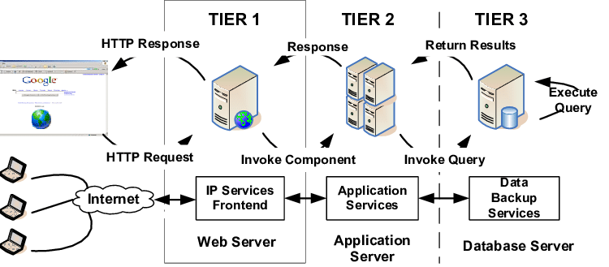

Slide 9
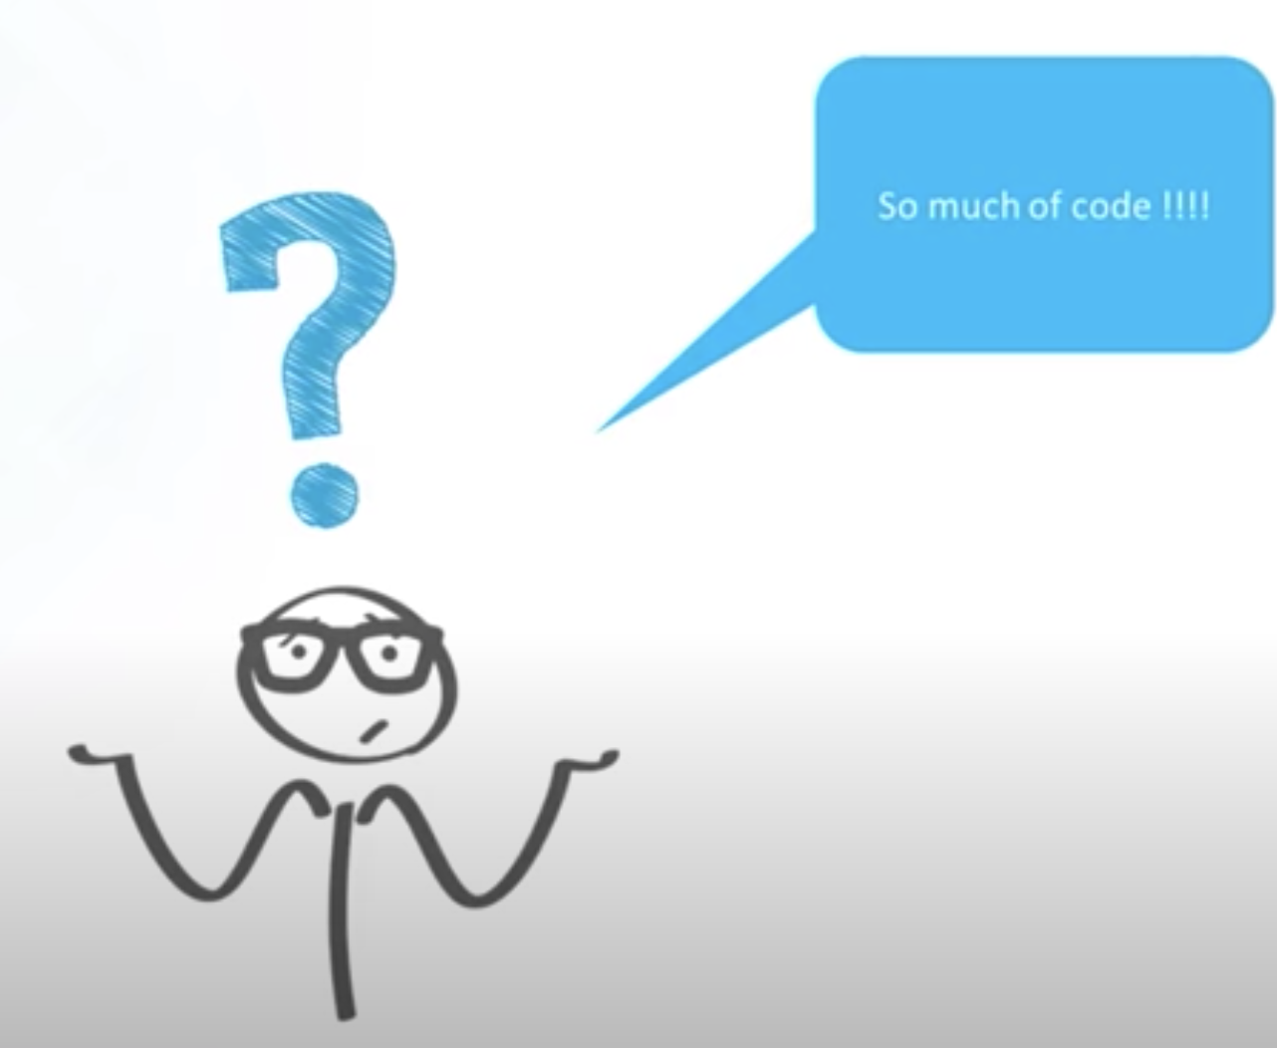
Requirement: Want to build mailing logic

Slide 10
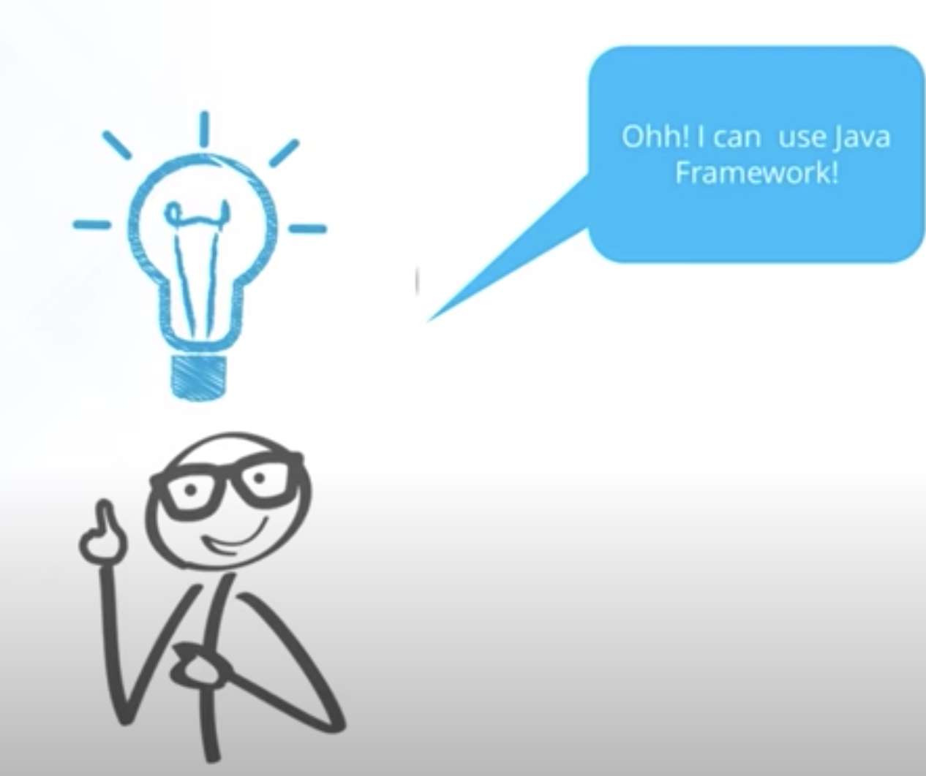

Slide 11
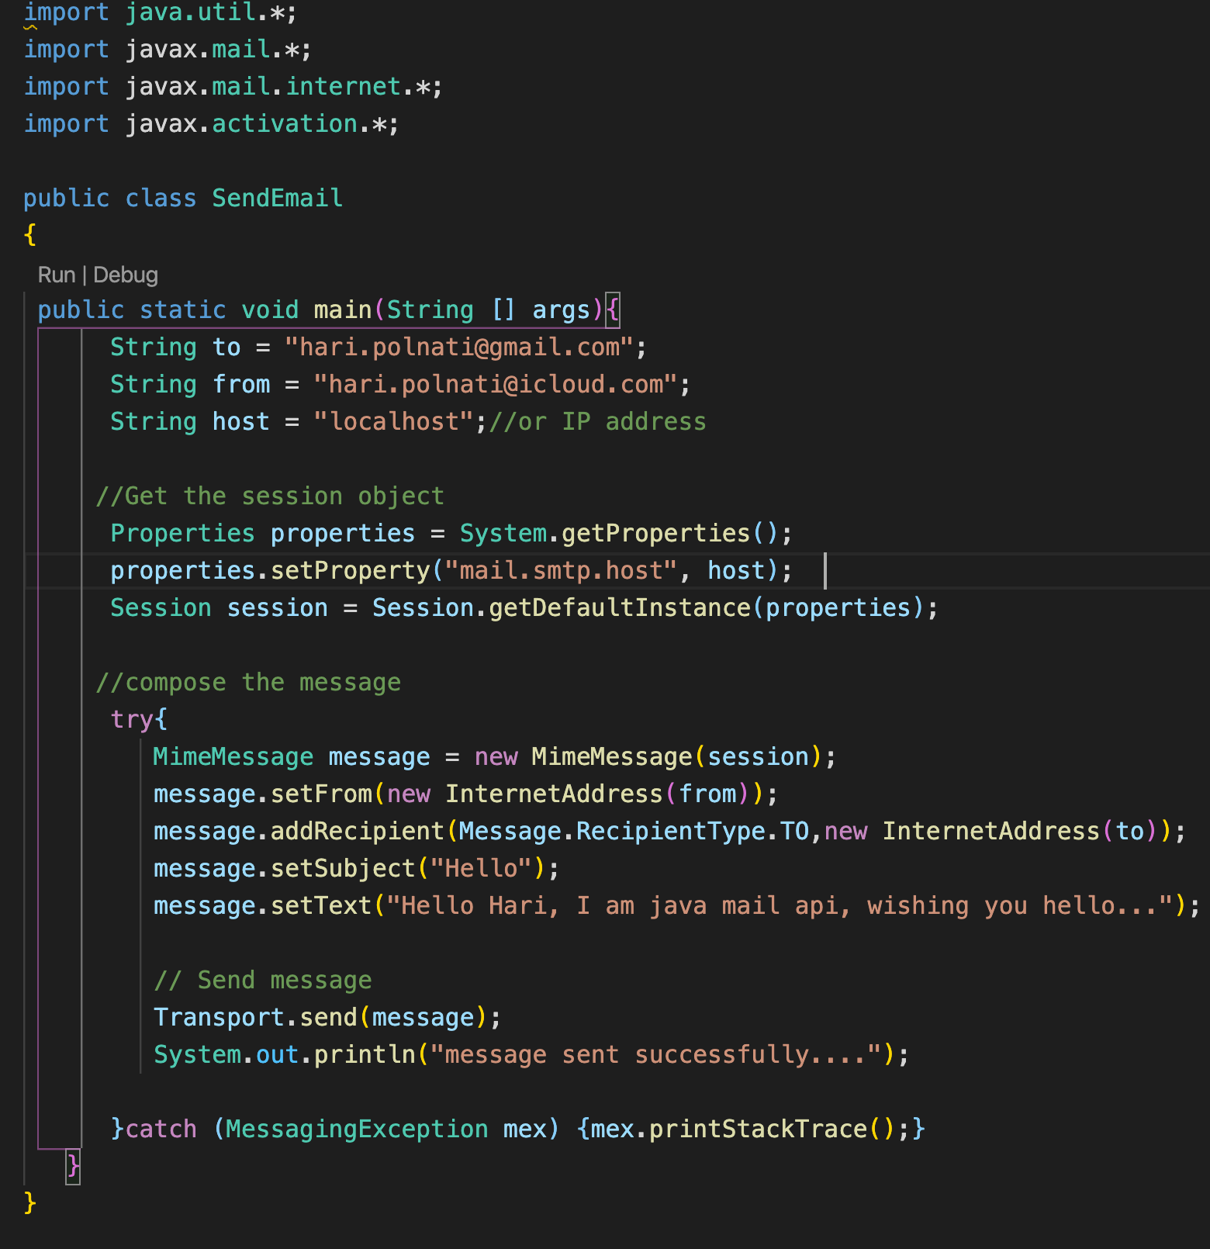
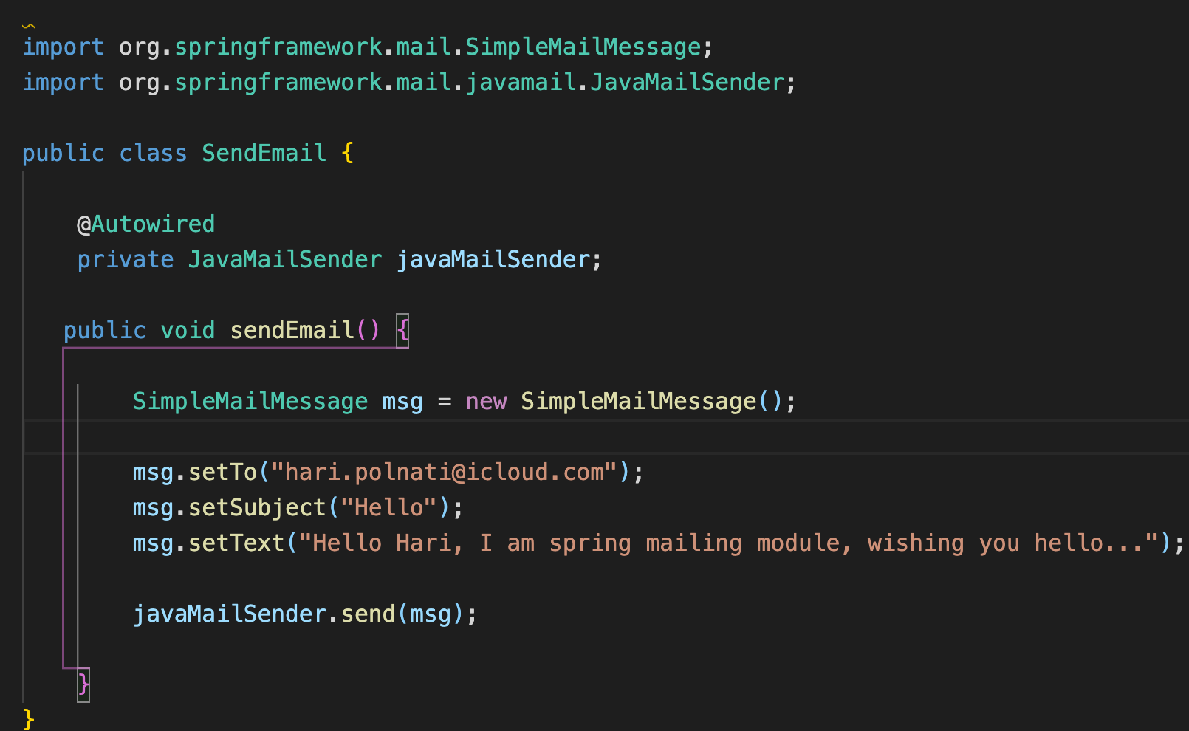
Plain Java Code
Spring Code

Slide 12
What and Why Spring ?
Application framework
Programming and Configurable model
Spring makes programming Java quicker, easier, and safer for everybody. Spring’s focus on speed, simplicity, and productivity has made it the world's most popular Java framework.
Modular framework for developing Enterprise applications in java
Open Source
Light weight
Simplicity
Testability
Loosely coupled

Slide 13
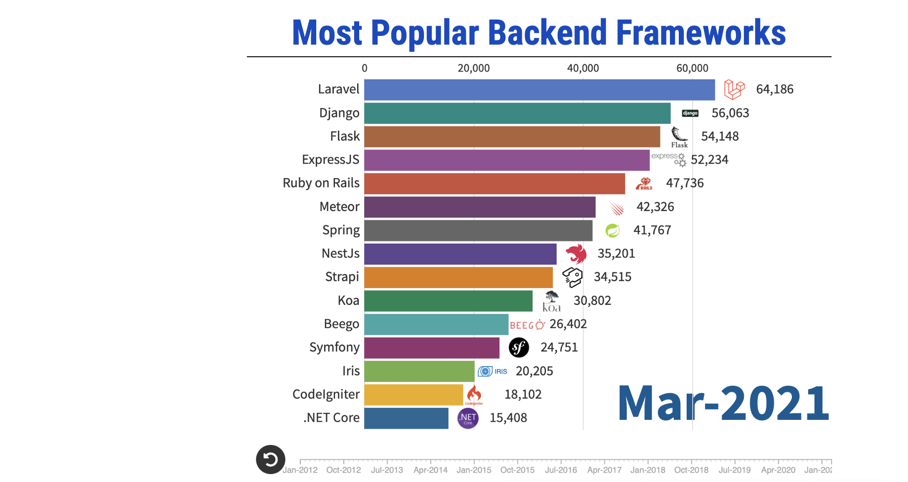
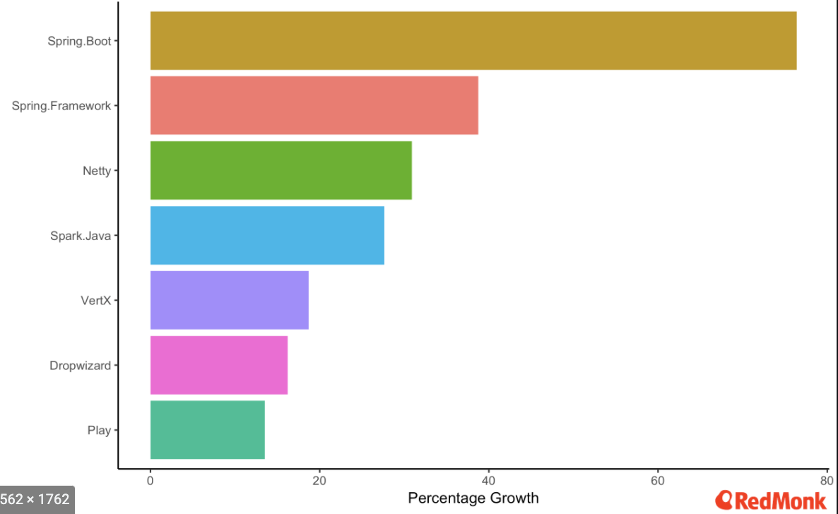
Popularity
Most Popular Java Backend Frameworks

Slide 14
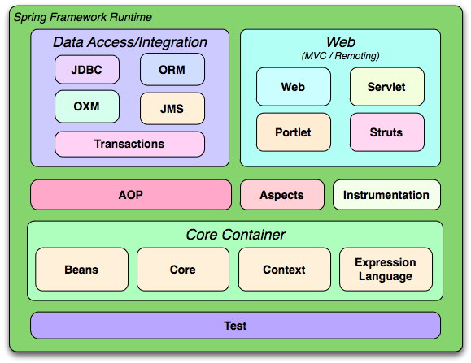
Spring Framework Architecture

Slide 15
Getting started with Spring Framework
Get Hands on Spring and understand:
Why spring?
Terminology
Tight Coupling vs Loose Coupling
IOC Container
Application Context
Component scan
Dependency Injection
Spring Beans
Auto wiring

Slide 16
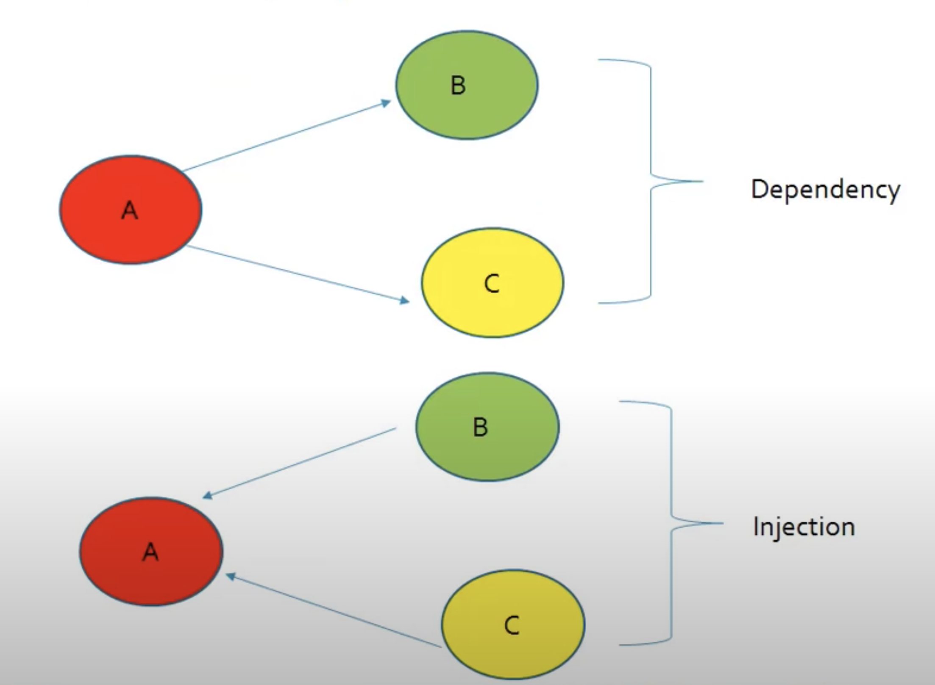
Requirement
B(int a){}
b1(){}
B b = new B()
C(){}
c1(){}

Slide 17
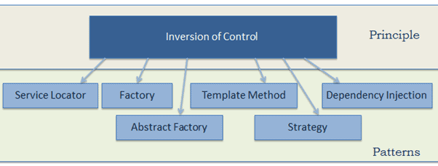
Loosely Coupled Solution:
Object of B and Object of C will be created by Class A
IOC: Principle by which the control of objects is transferred to a container or framework
DI: A pattern through which IOC is implemented
Rather than Creating in Class A Container will create Obj B and Object C for A and injected into class A

Slide 18
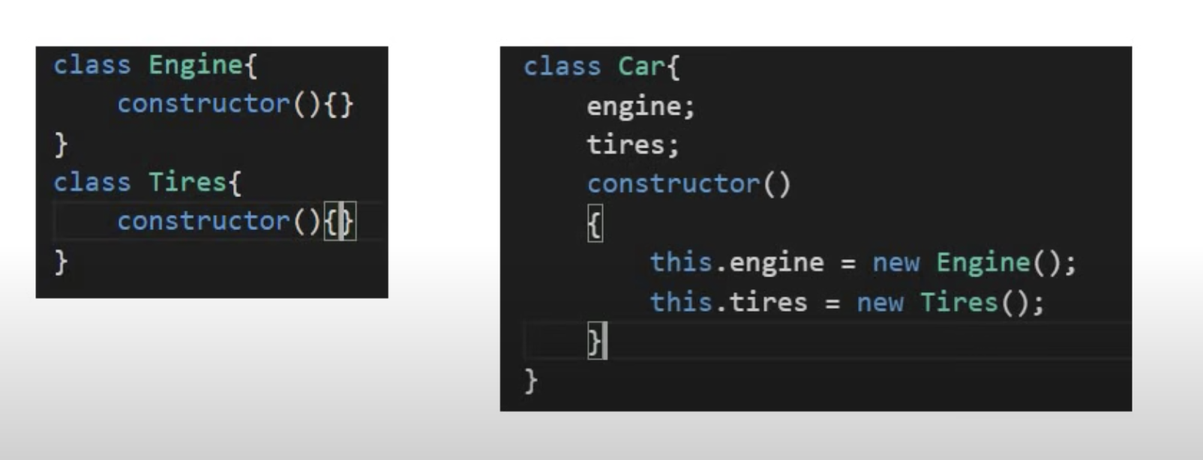
Code Without DI

Slide 19
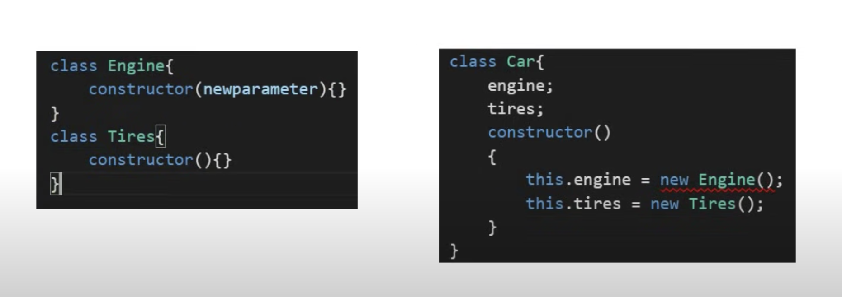
Code Without DI Continues…

Slide 20
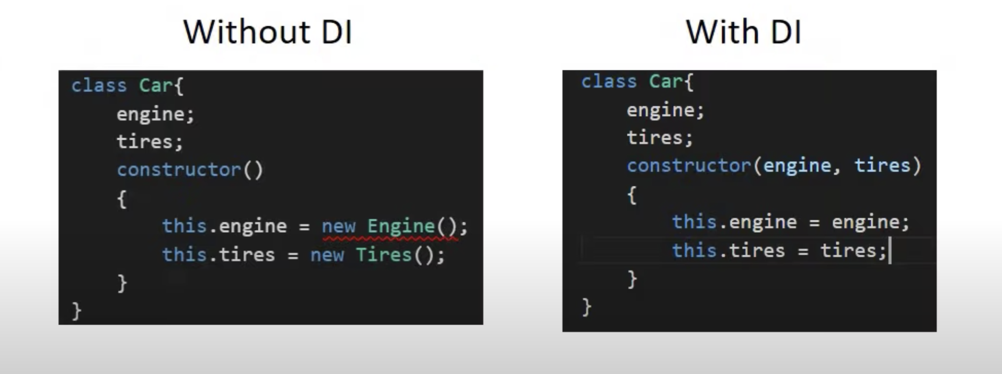
DI Design pattern
Dependency Injection (DI) is a coding pattern in which a class receives its dependencies from external sources rather than creating them itself.

Slide 21
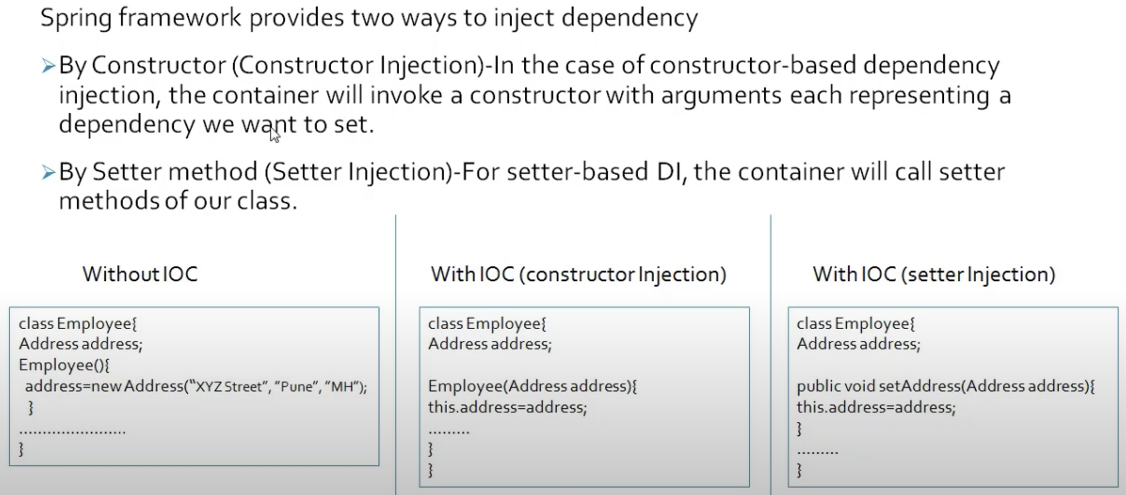
https://mkyong.com/spring/spring-loosely-coupled-example/

Slide 22
Spring IOC container
An IoC container is a common characteristic of frameworks that implement IoC.
In the Spring framework, the interface ApplicationContext represents the IoC container. The Spring container is responsible for instantiating, configuring and assembling objects known as beans, as well as managing their life cycles

Slide 23
Problems with Spring
Huge framework
Multiple setup steps
Multiple configuration steps
Multiple build and deploy steps
Can we abstract these steps ?

Slide 24
What is Spring Boot
Makes easy to create standalone, production grade java-based apps that’s you can just run
Tool/Project to create spring-based Applications
Convention over configuration ( Covers 80% of use cases)

Slide 25
Primary goal of Spring Boot
To provide a radically faster and widely accessible ‘getting started’ experience for all Spring development
To be opinionated out of the box, but get out of the way quickly as requirements start to diverge from the defaults
To provide a range of non-functional features that are common to large classes of projects (e.g. embedded servers, security, metrics, health checks, externalized configuration)
Spring Boot does not generate code and there is absolutely no requirement for XML configuration.

Slide 26
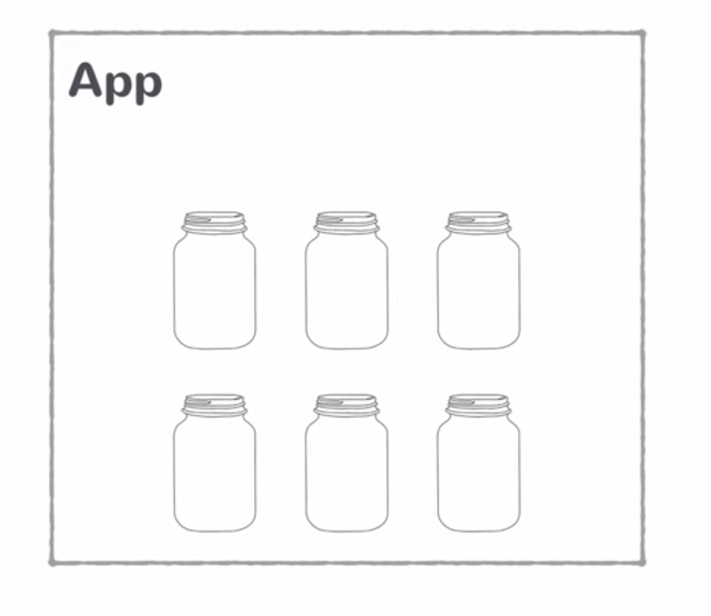
Java dependencies

Slide 27
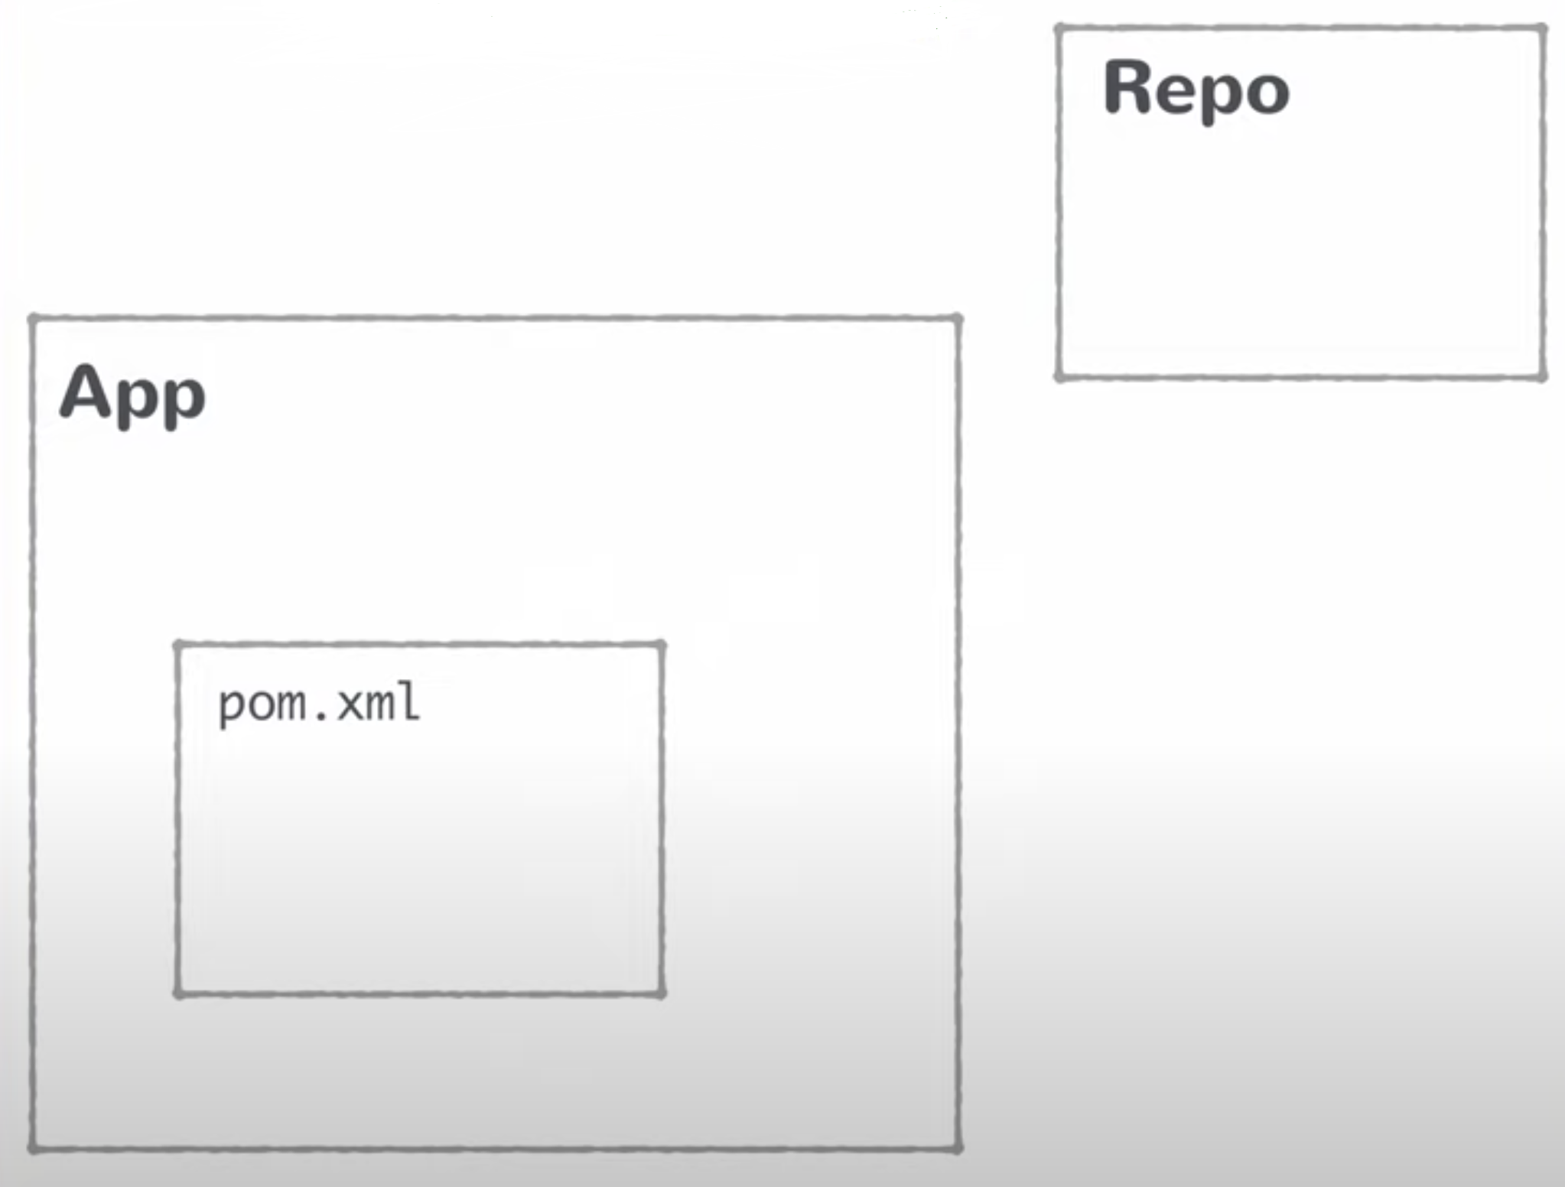
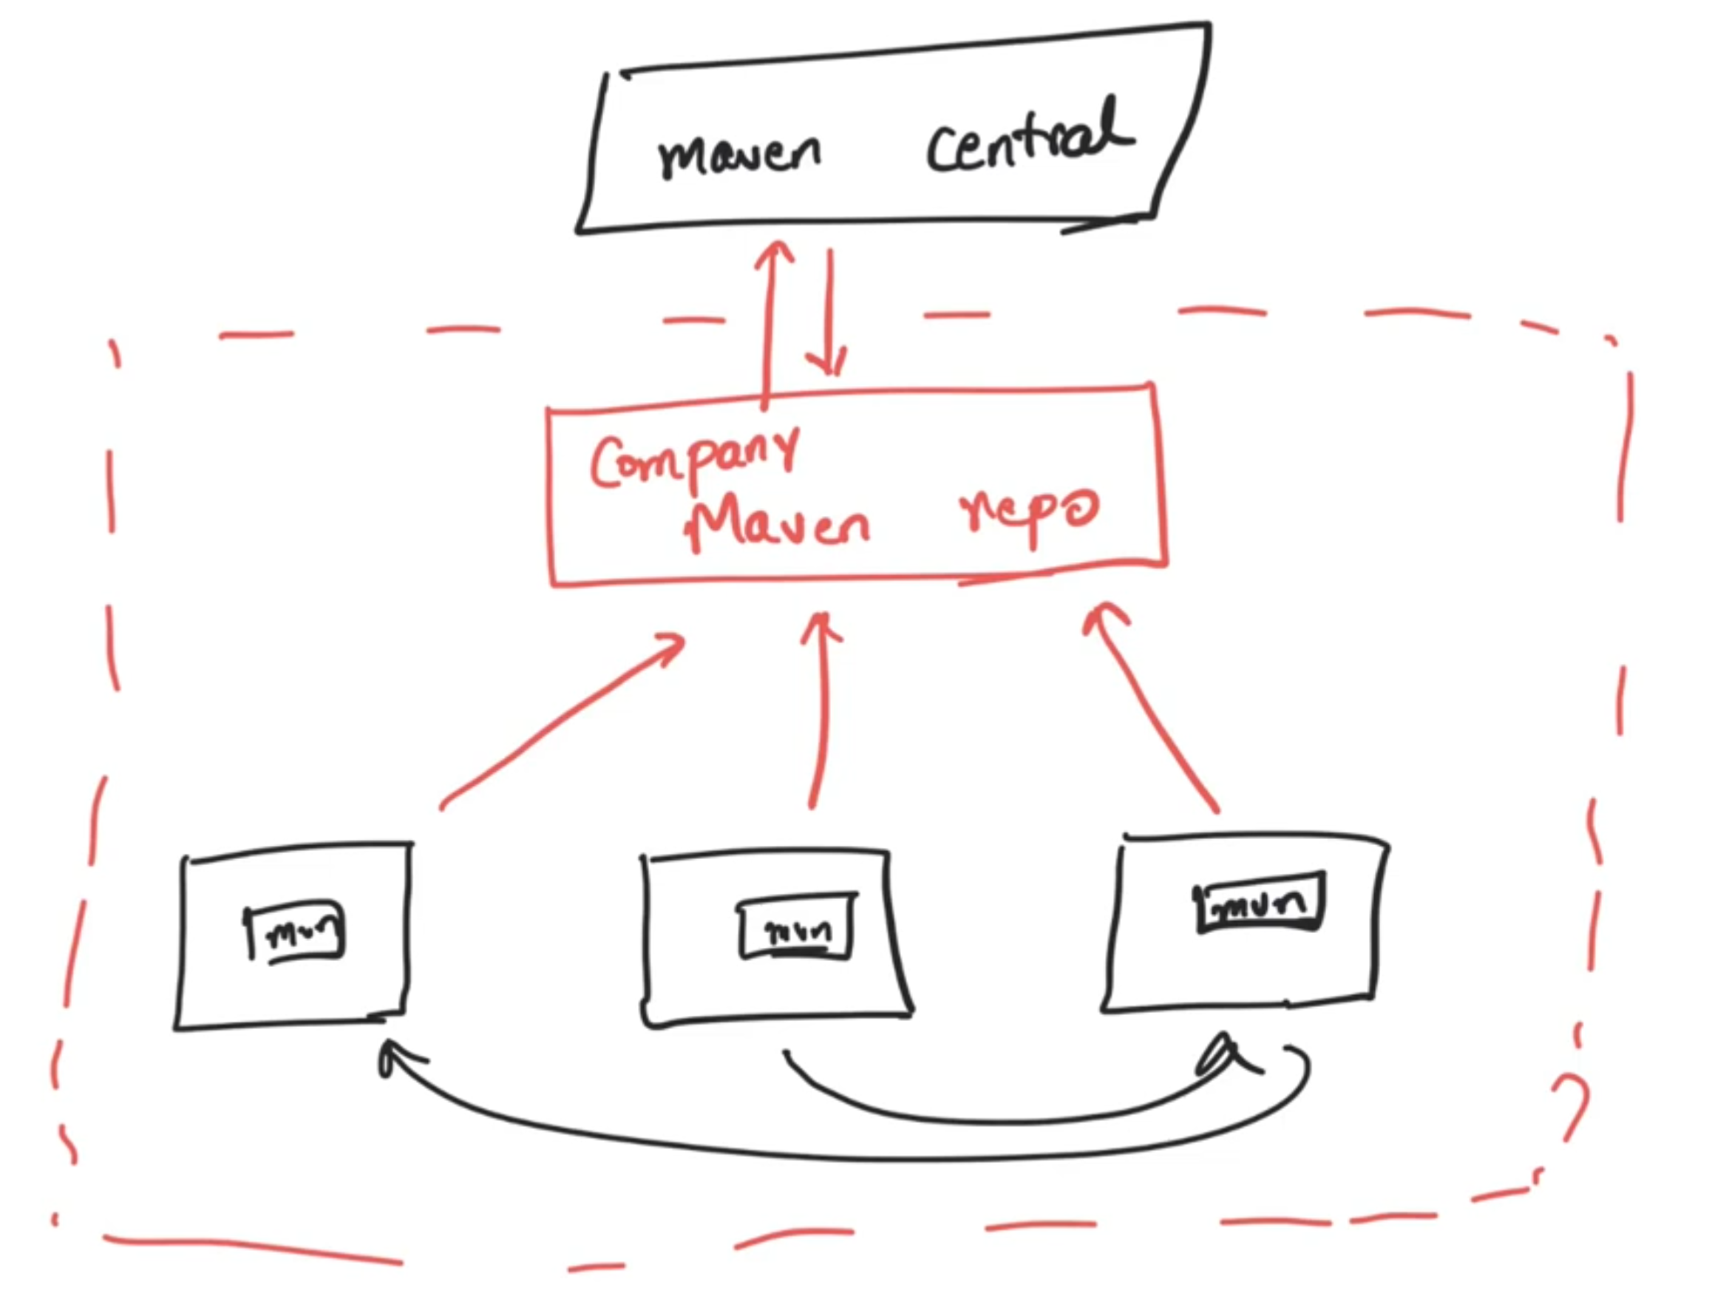
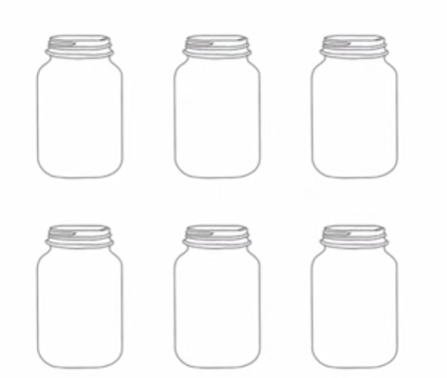
With Maven
jfrog artifactory

Slide 28
Create a Spring boot Project
https://start.spring.io/
From IDE Spring starter

Slide 29
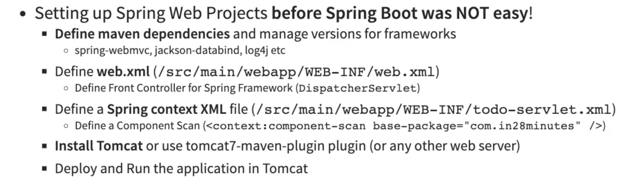
Before Spring Boot

Slide 30
Spring Boot Starters

Slide 31
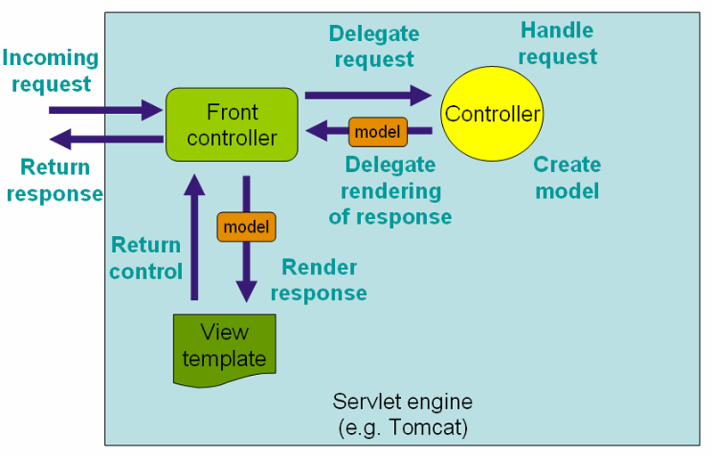
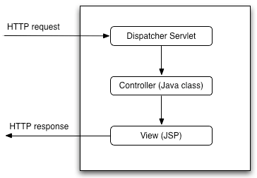
Dispatcher Servlet
Ex: Drug
Controller
/json
https://docs.spring.io/spring-framework/docs/3.0.0.M4/reference/html/ch15s02.html

Slide 32
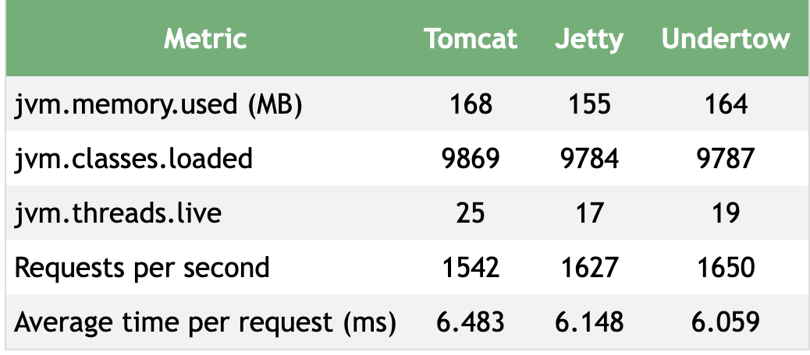
Embedded Servers
Convenience
Servlet container config is now application config
Standalone application
Useful Microservices architecture
The memory footprint of Tomcat, Jetty, and Undertow was comparable with Undertow requiring slightly more memory than the other two and Jetty requiring the smallest amount.
For our benchmark, we found that the performance of Tomcat, Jetty, and Undertow was comparable but that Undertow was clearly the fastest and Jetty only slightly less fast.
https://www.baeldung.com/spring-boot-servlet-containers

Slide 33
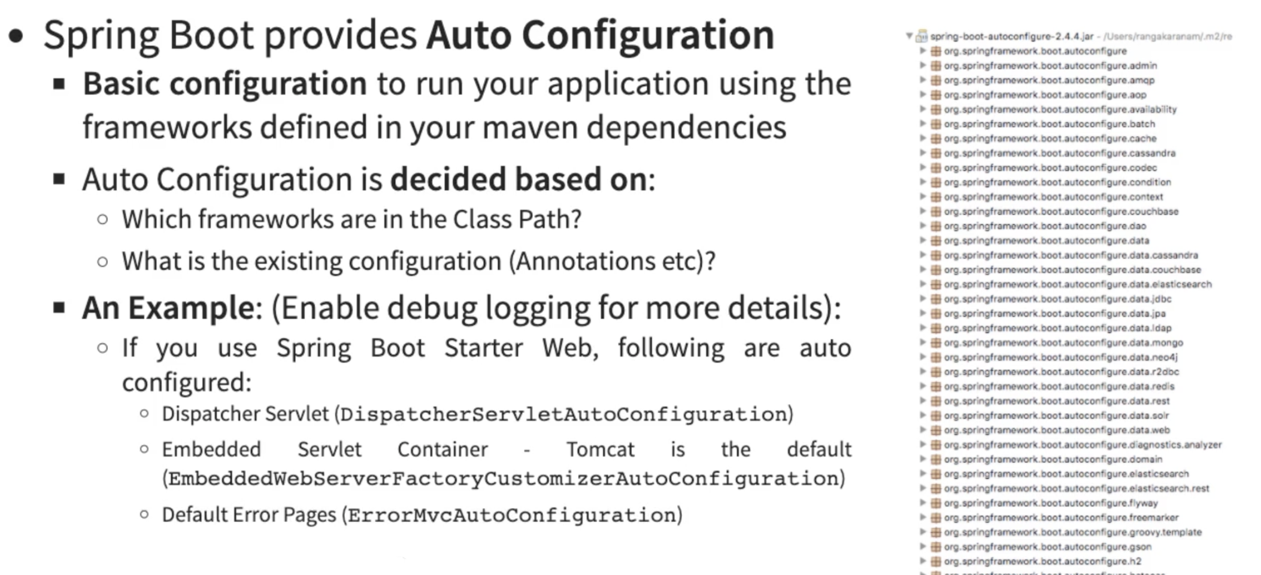
Spring boot Auto Configuration
JacksonAutoConfiguration
https://dzone.com/articles/the-springbootapplication-annotation-example-in-ja

Slide 34
Project Lombok
Project Lombok is a java library that automatically plugs into your editor and build tools, spicing up your java. Never write another getter or equals method again, with one annotation your class has a fully featured builder, Automate your logging variables, and much more.
Getters/Setters, Constructors – So Repetitive
https://www.baeldung.com/intro-to-project-lombok

Slide 35
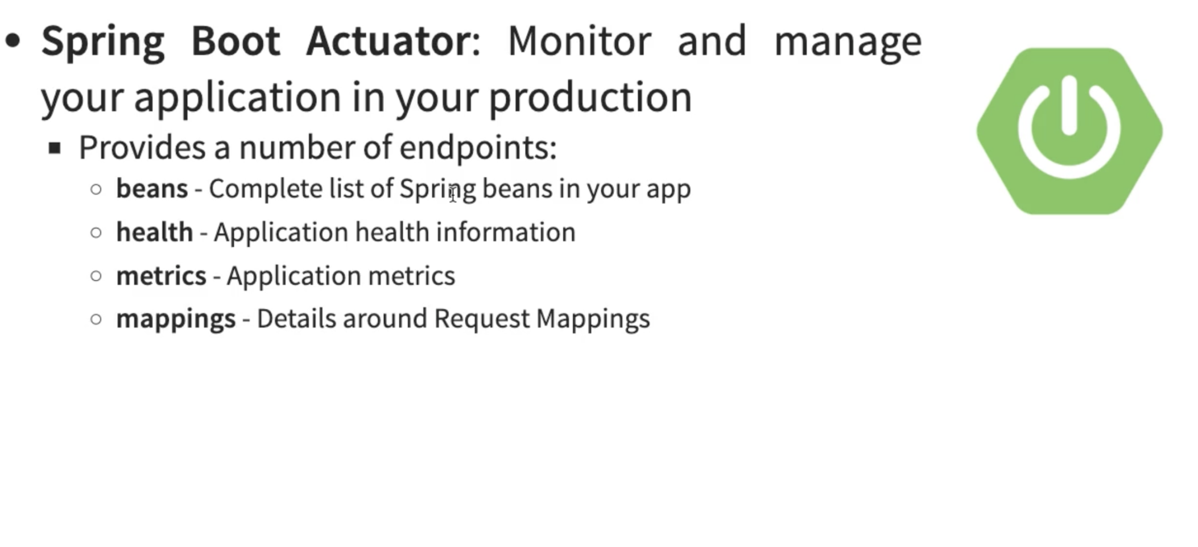
Spring Boot Dev tools: Increase developer productivity
No need to restart the server for every code change – if you add devtools dependency it will automatically do it for you
Add in yml or prop -> management.endpoints.web.exposure.include=*
http://baseurl/actuator

Slide 36
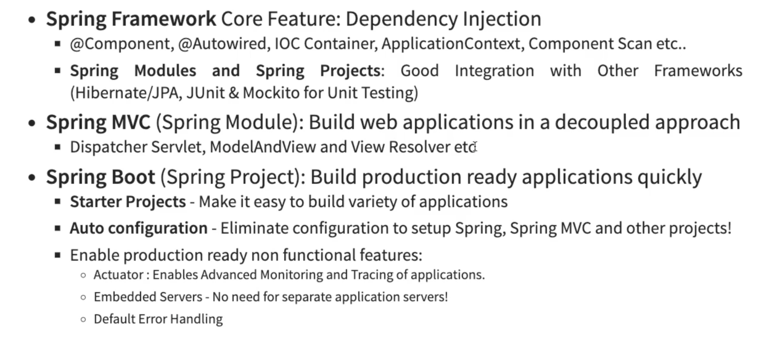
Spring Vs Spring MVC vs Spring Boot

Slide 37
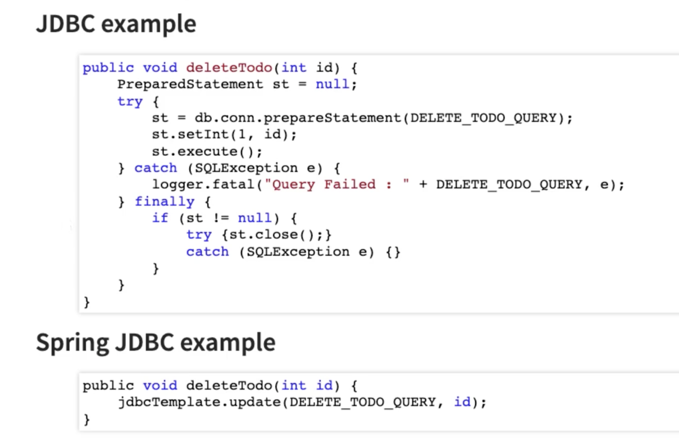
JDBC vs Spring JDBC

Slide 38
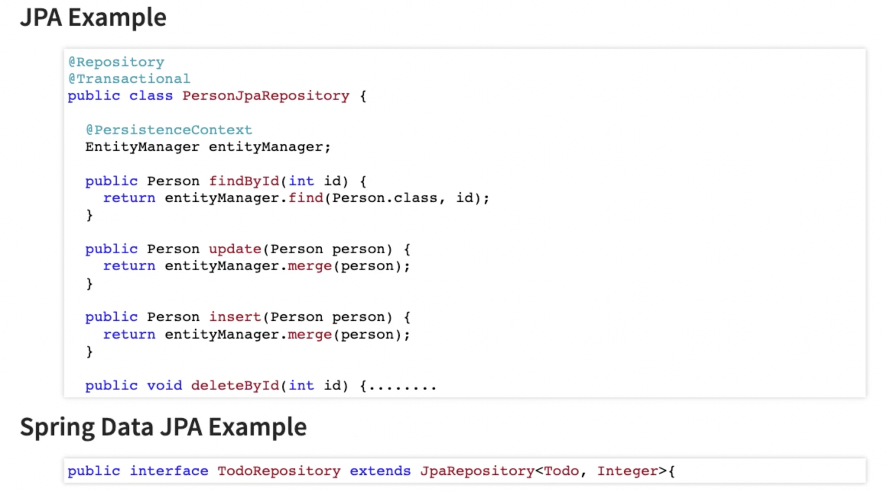
JPA vs Spring Data JPA

Slide 39
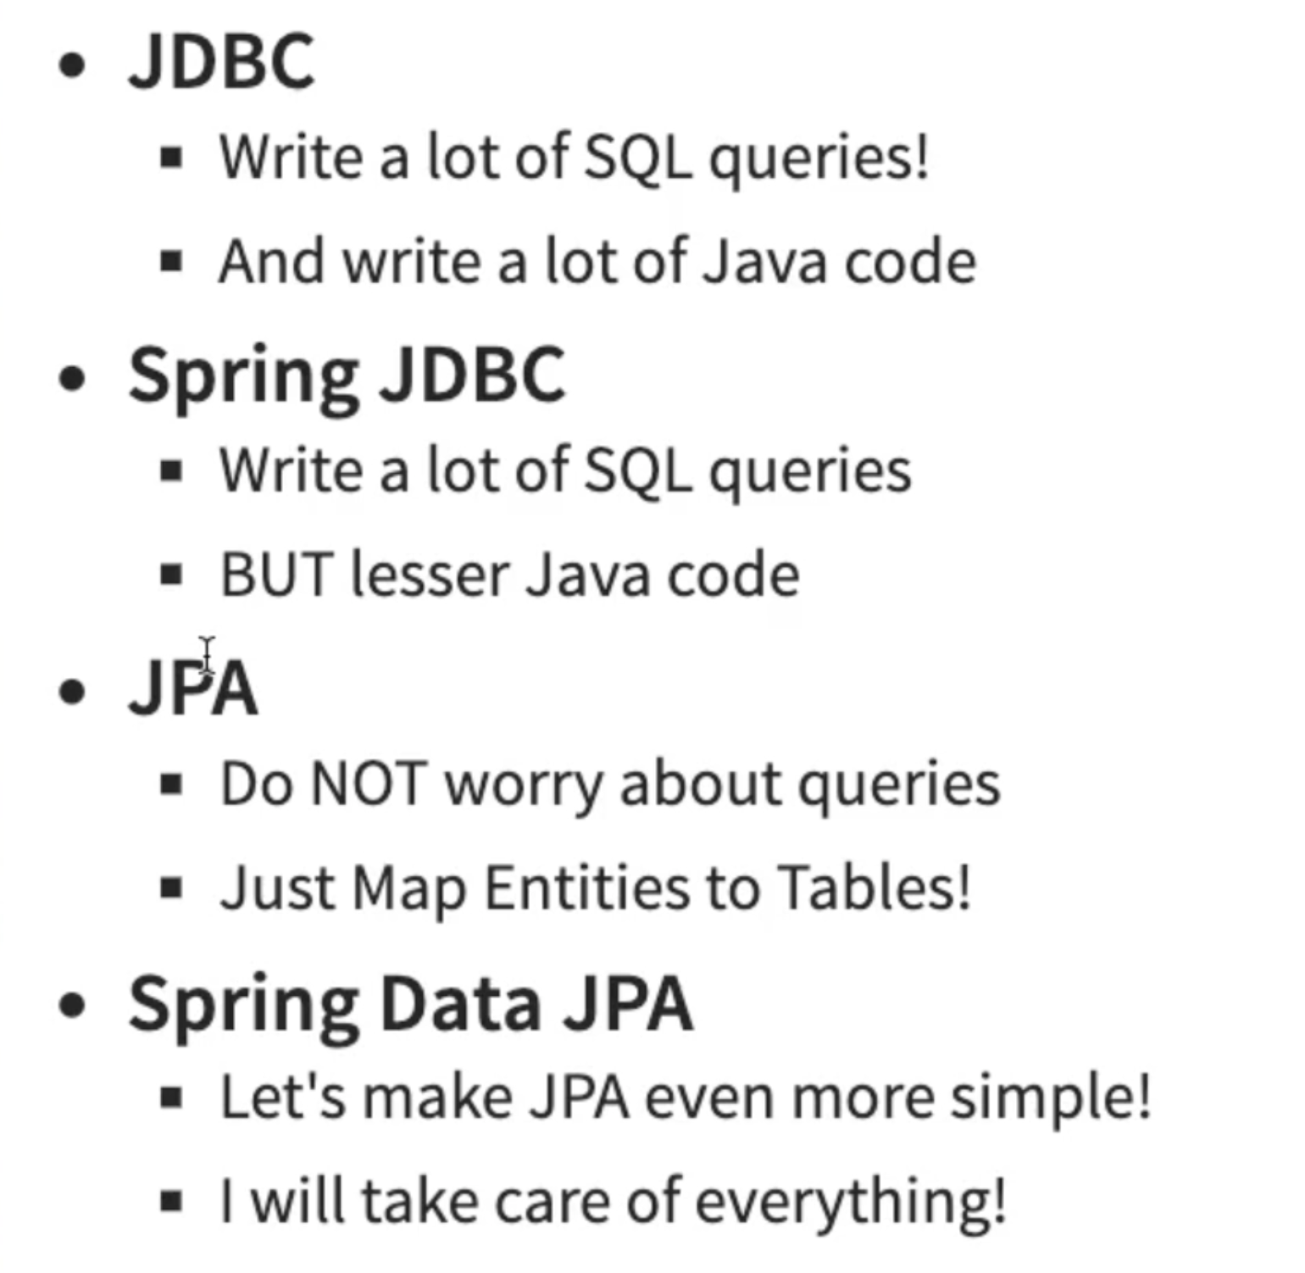

Slide 40
Exception Handling
Before Spring 3.2, the two main approaches to handling exceptions in a Spring MVC application were HandlerExceptionResolver or the @ExceptionHandler annotation. Both have some clear downsides.
Since 3.2, we've had the @ControllerAdvice annotation to address the limitations of the previous two solutions and to promote a unified exception handling throughout a whole application. (Spring supports exception handling by a global Exception Handler (@ExceptionHandler) with Controller Advice (@RestControllerAdvice).
Now Spring 5 introduces the ResponseStatusException class — a fast way for basic error handling in our REST APIs.
All of these do have one thing in common: They deal with the separation of concerns very well. The app can throw exceptions normally to indicate a failure of some kind, which will then be handled separately.

Slide 41
Logging

Slide 42
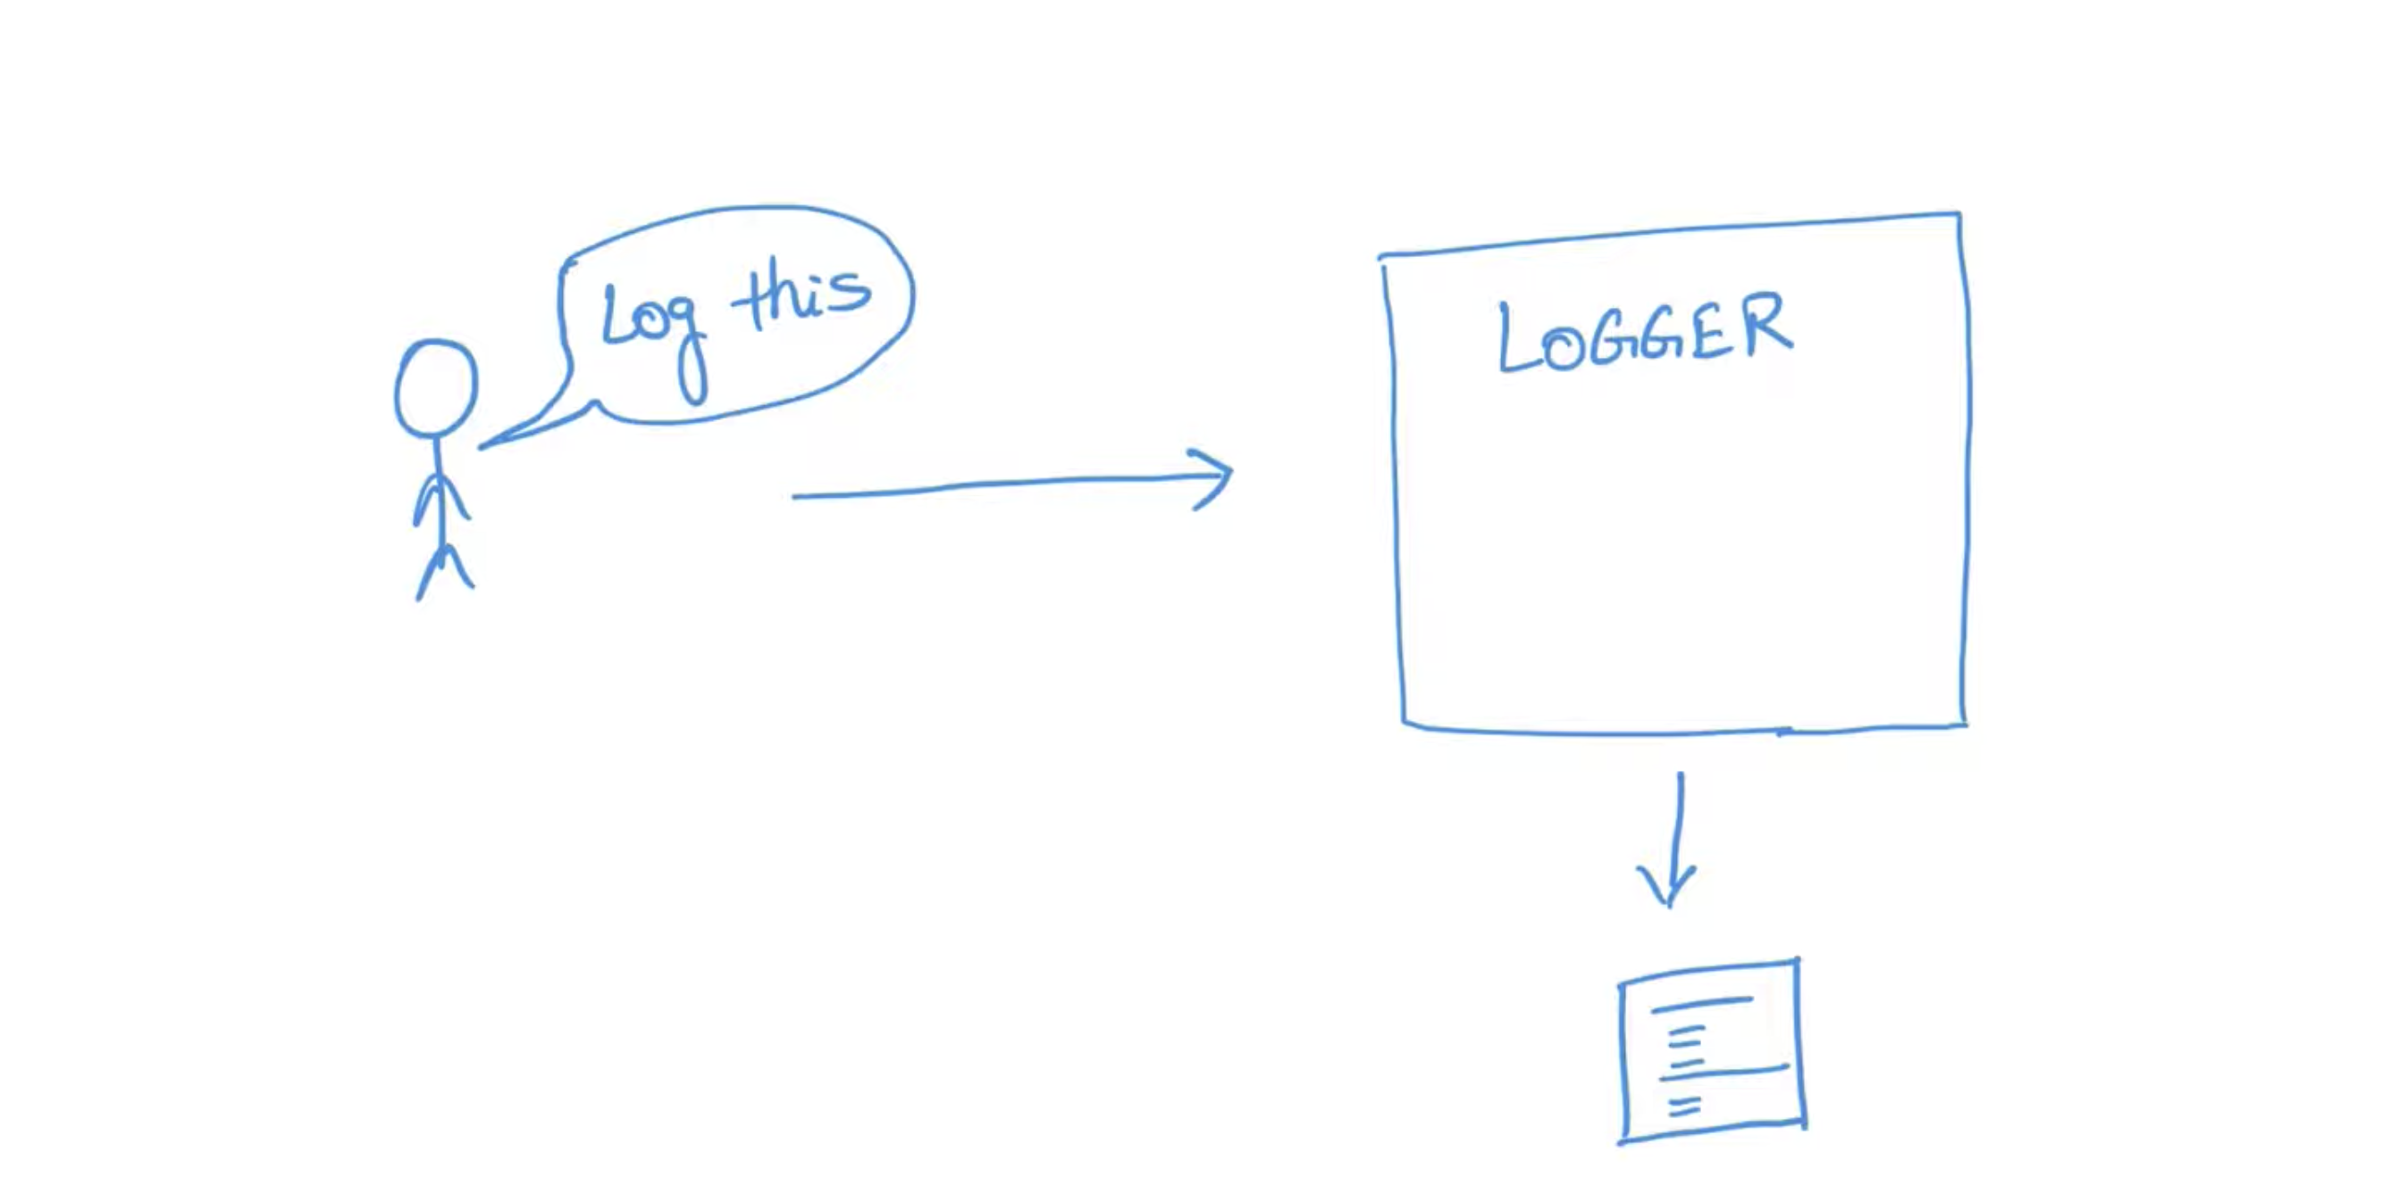

Slide 43
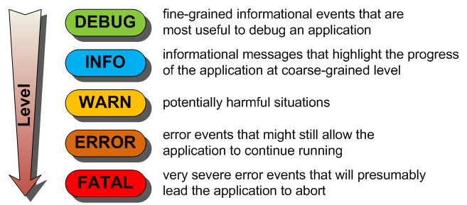
Two popular libraries
Log4j2
Logback

Slide 44
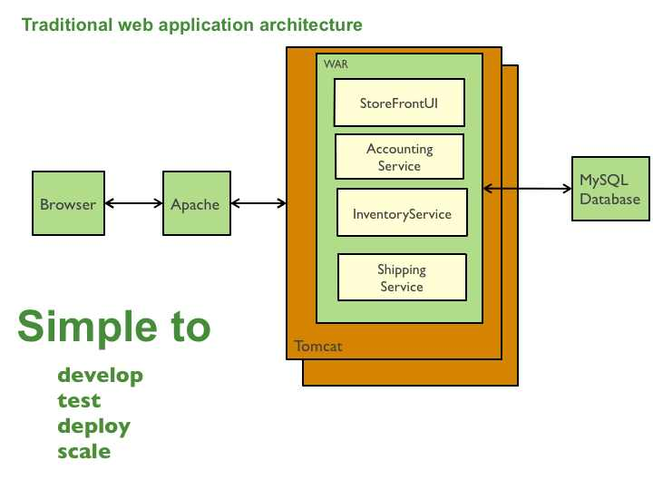
Monolith
Application has all its components reside together as one unit

Slide 45
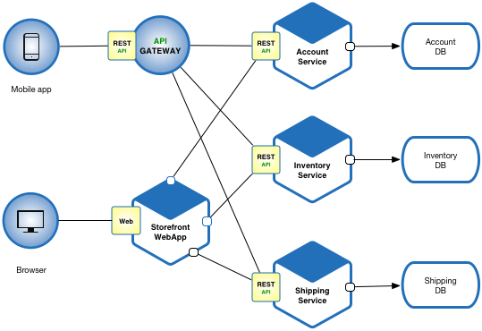
Microservices
Microservices - also known as the microservice architecture - is an architectural style that structures an application as a collection of services that are
Highly maintainable and testable
Loosely coupled
Independently deployable
Organized around business capabilities
Technology Independent
Owned by a small team – capable to develop by small team
The microservice architecture enables the rapid, frequent and reliable delivery of large, complex applications. It also enables an organization to evolve its technology stack.
https://microservices.io/

Slide 46
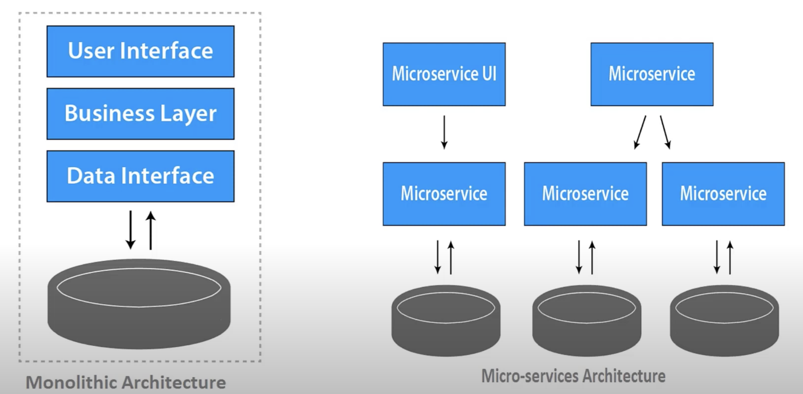
Mono vs Micro Services

Slide 47
Docker
Terms:
Physical server
VM
Docker
K8S

Slide 48
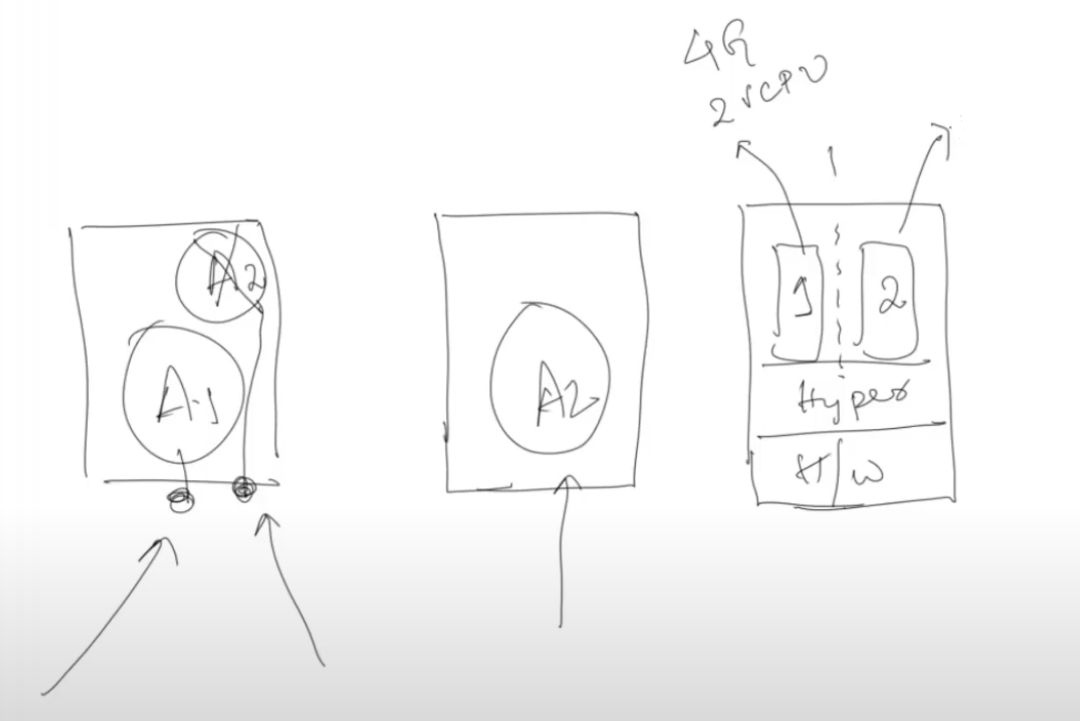
Physical server vs VM
A1 and A2 running on same server
Problem ?
2. A1 and A2 running on two different server
Problem ?
3. Drastic change to VM ?

Slide 49
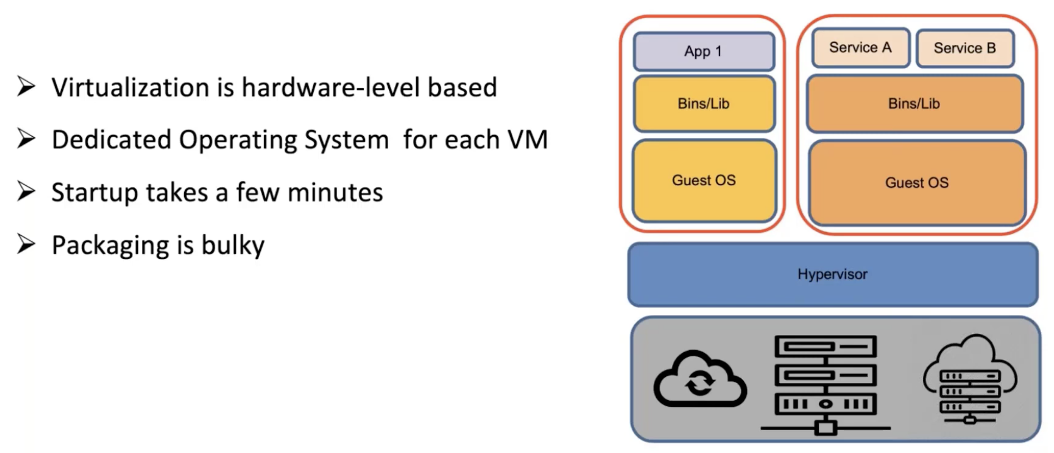
Virtual Machine

Slide 50
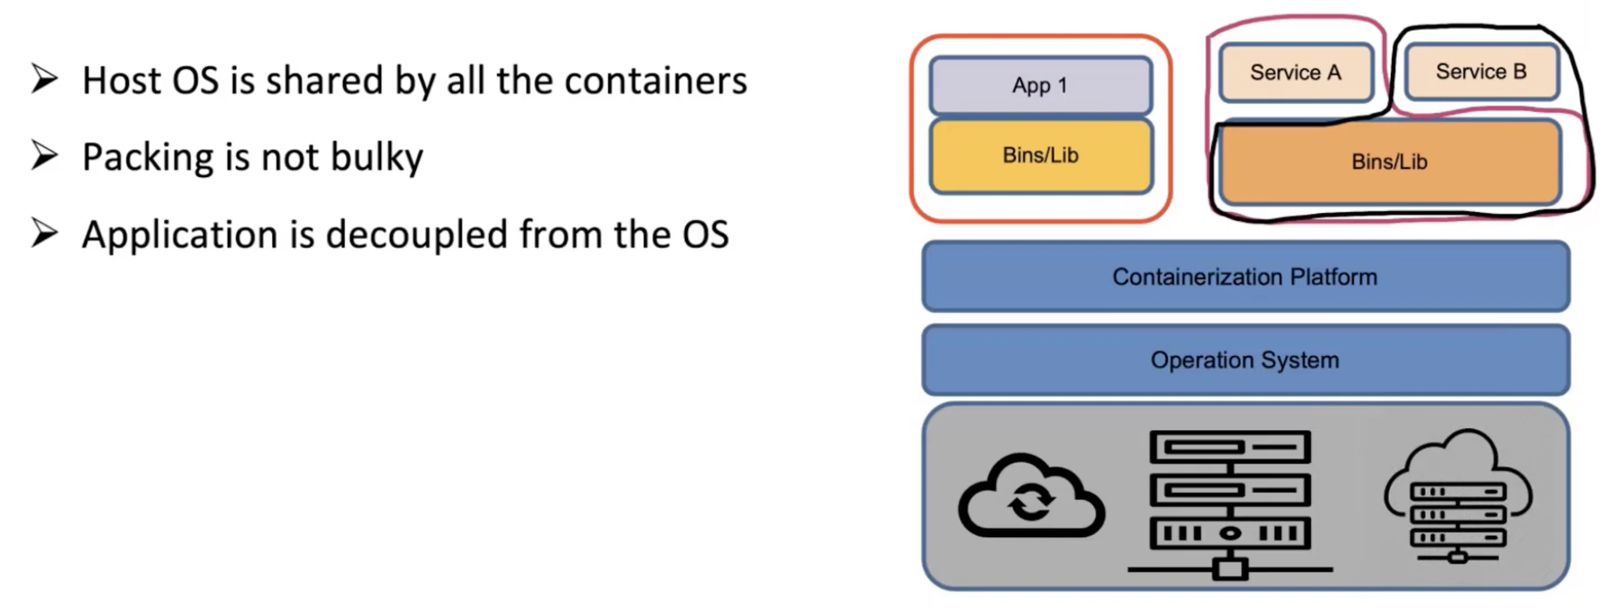
Containers

Slide 51
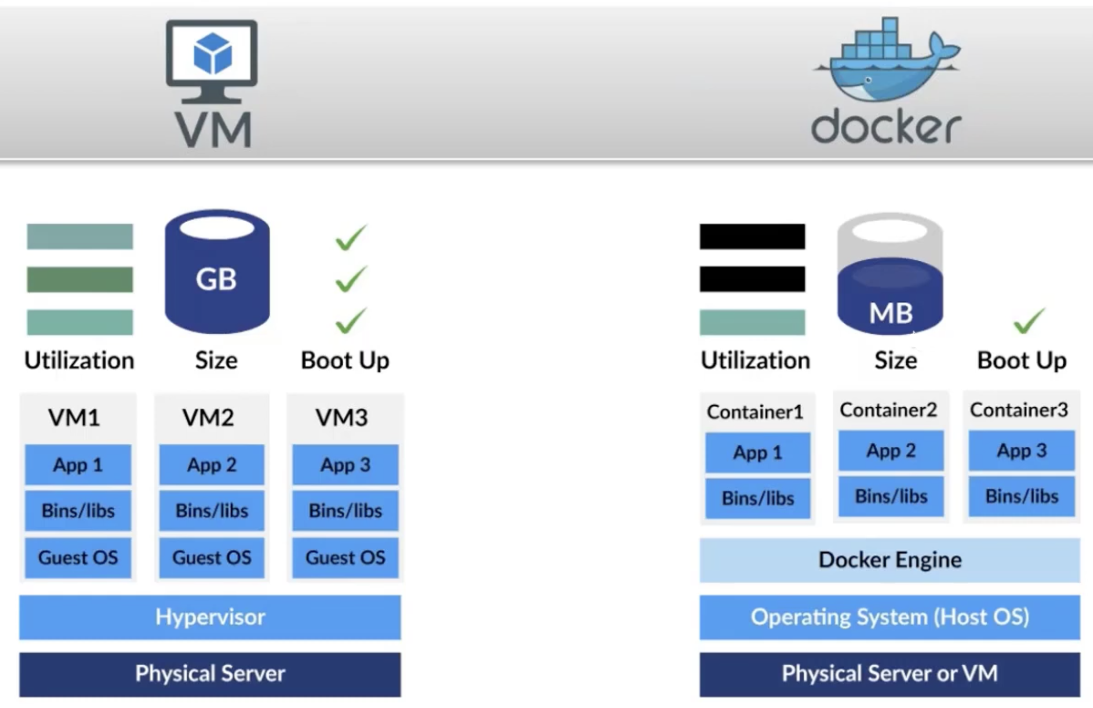
VM vs Containers

Slide 52
Containers
Containers are a type of software that can virtually package and isolate applications for deployment
A container is a standard unit of software that packages up code and all its dependencies, so the application runs quickly and reliably from one computing environment to another. A Docker container image is a lightweight, standalone, executable package of software that includes everything needed to run an application: code, runtime, system tools, system libraries and settings.
Docker is Platform for developers or admin to develop, ship and run applications using container

Slide 53
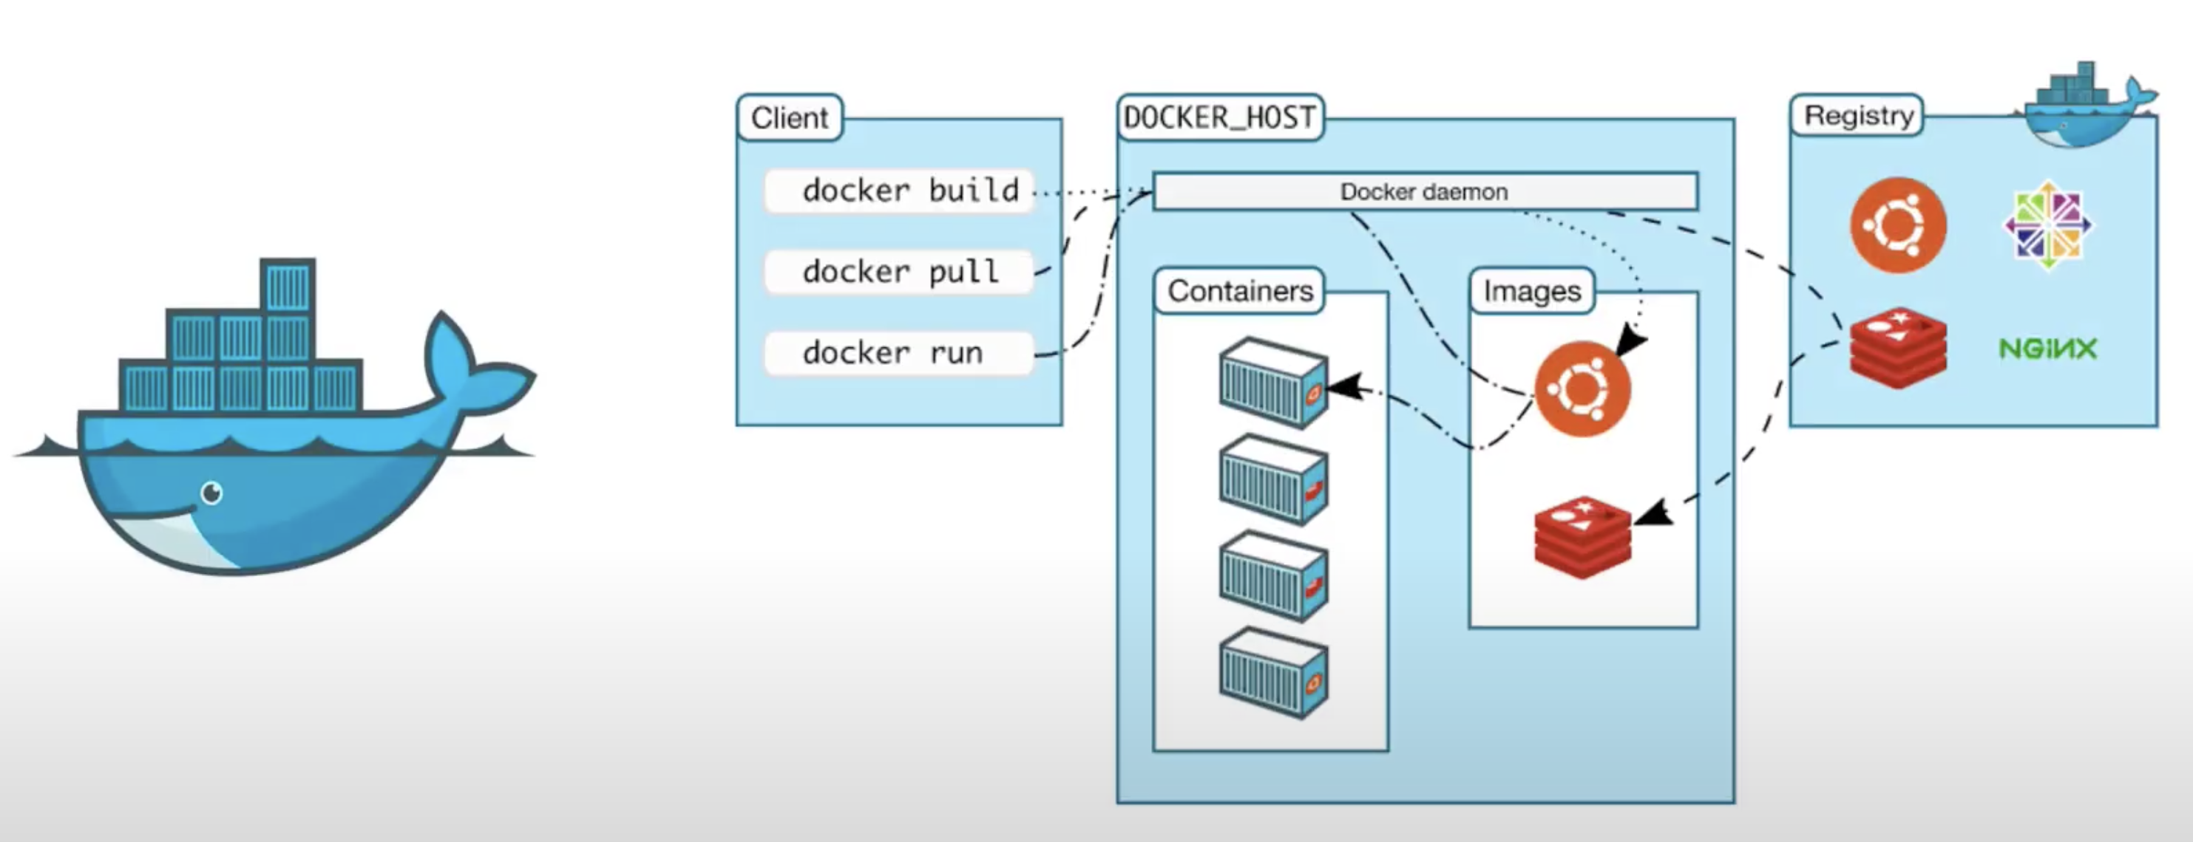
Docker and Its components
Docker uses client server architecture

Slide 54
Docker limitations
Dynamic IP – (container restarts)

Slide 55
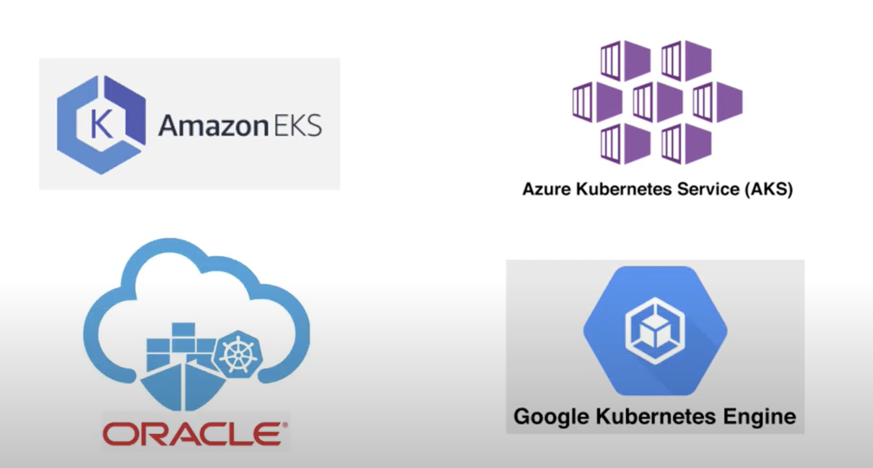
Kubernetes (K8S)
Opensource orchestration tool for deploying, maintaining and scaling up containerized applications.
Automates application deployment, scaling and management
Originally developed/designed by Google, now managing by CNCF
Every cloud provider manages K8S service in cloud
K8S Architecture

Slide 56
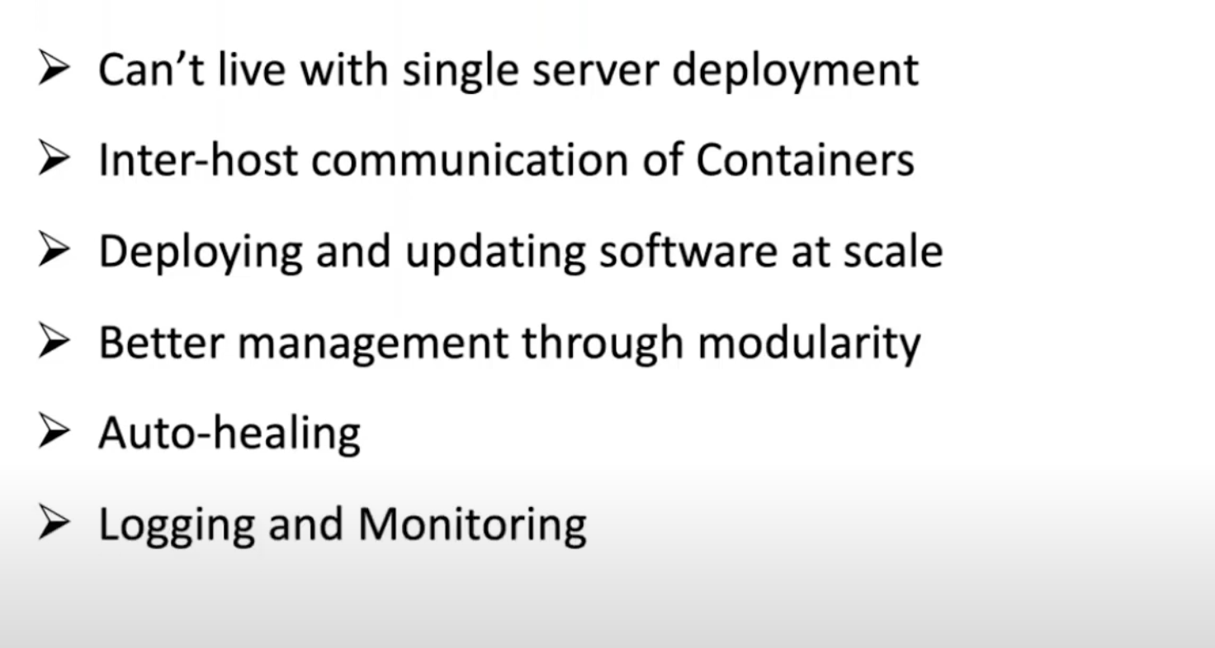
Why K8S

Slide 57
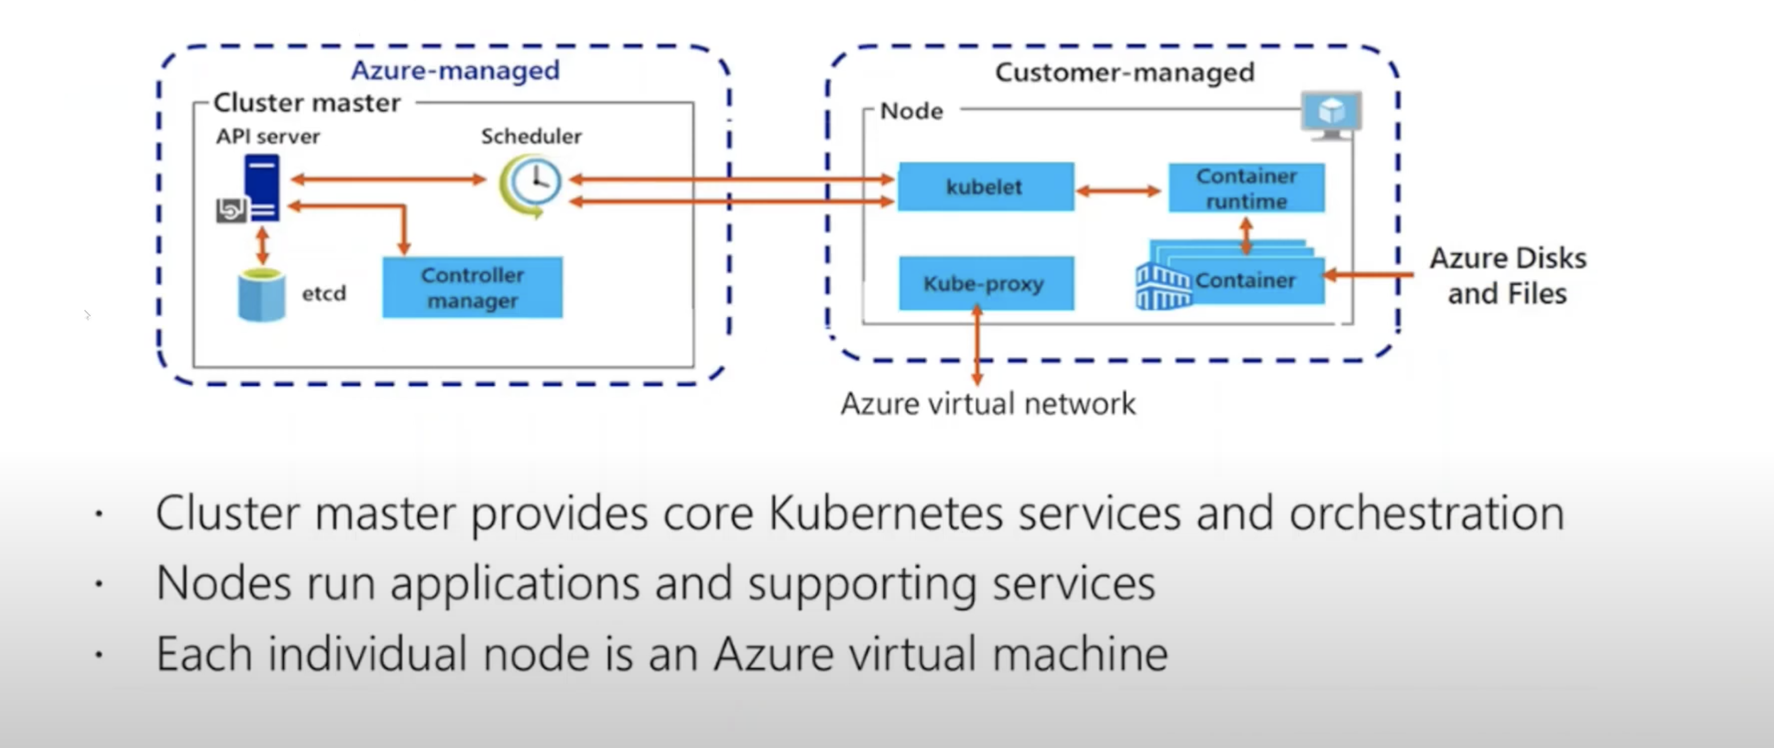
Azure K8S Service

